Slide 1
How to Structure an Analytics Business Case Presentation
Francis Silva
May 16, 2020

Slide 2
Agenda
Who Am I?
Why is Learning How to Create an Analytics Business Case Presentation Important? – 10 Min
3 Different Structures for Analytics Business Case Presentations – 20 Min
Team Exercise -> Create a Business Case Presentation Structure – 50 Min

Slide 3

Who Am I?
Name: Francis Silva
Home Town:
Toronto, ON
School:
University of Windsor – BOR
York University – BA
Queens University – MMA
Current Work:
Vice President – Data & Analytics at Bond
Previous Work:
Director – Partner Analytics, AirMiles /LoyaltyOne
Director – Head of Analytics and Technology, Global Consulting at LoyaltyOne
Director – IT Business Engagement at Loblaw/Shoppers Drug Mart

Slide 4
Why is Learning How to Create an Analytics Business Case Presentation Important?

Slide 5

1. Analytics Solutions Are New

Slide 6

Logical Structure to Identify Touch Points, Dependencies and Implementation Risk

Slide 7

2. Analytics is Huge

Slide 8

Logical Structure that Provides Focus on the Core Solution

Slide 9
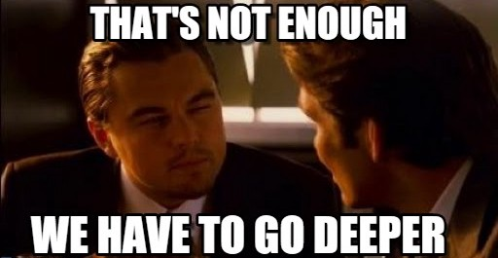
3. Analytics Solutions Are Complex and Unintuitive

Slide 10
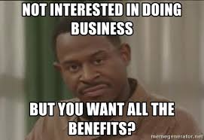
Framework for Draw Out Benefits

Slide 11
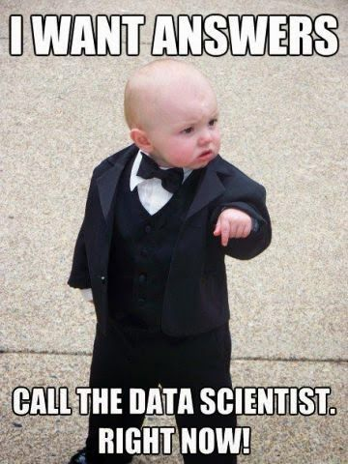
Business Stakeholders Just Want the Answer

Slide 12
3 Different Structures for Analytics Business Case Presentations

Slide 13
Methods
Different Structures for Different Situations
1
2
3
SCQA
Business Case
Motivated Sequence
The Quintessential Consultant
The Gold Standard
The Narrative

Slide 14
Method 1 – The Quintessential Consultant

Slide 15
Method 1 – The Quintessential Consultant

Slide 16
SCQA – The Quintessential Consultant
Used for executive briefings and update meetings.
Situation (Background):
Tell the audience what they already know
Complication (Problem/Issue):
Describe the reason for ones engagement; a change before a stable situation
Question (Problem Statement):
Define the scope and goal of your engagement
Answer (Recommendation):
Define how you will achieve the goal
Appendix:
Everything else including supporting graphs and analysis
Slide 1
Slide 2
Slide 3

Slide 17
SCQA – The Quintessential Consultant Example 1
Situation (Background):
Motionball runs multiple sporting events for charity each year that are funded by sponsors
Complication (Problem/Issue):
Sponsors are evaluating their charity spend and want to know what type of people Motionball is engaging and whether that aligns to their marketing strategy
Question (Problem Statement):
How can Motionball better understand their donor base?
Answer (Recommendation):
Segment the donor base based on engagement with Motionball and then overlay demographic data to create donor profiles

Slide 18
SCQA – The Quintessential Consultant Example 2
Situation (Background):
Current Grocery Store X runs a large promotional campaign every year that costs them $3MM
Complication (Problem/Issue):
Senior executives do not believe the incremental sales from this campaign offset the cost of $3MM
Question (Problem Statement):
How can Grocery Store X calculate the value of the incremental sales of the promotional campaign
Answer (Recommendation):
Grocery Store X can use a 4 Point method (LYPre, LYPromo, Pre, Promo) to calculate incremental sales, this method is useful as it takes into account seasonality and year over year trend
Appendix:
Slides with: the calculations and methodology, case study, data required, alternative methods

Slide 19
SCQA – The Quintessential Consultant Example 3
Situation (Background):
Grocer Y has had slowing revenue growth and stagnant sales in the center of store (Packaged goods)
Complication (Problem/Issue):
Grocer Y’s best customer segment comes in very frequently but only purchase pre-made sandwiches during lunch and does not by anything else
Question (Problem Statement):
How can grocer Y grow share of stomach with these best customers?
Answer (Recommendation):
Send these customers rich targeted offers that incentivize them to try purchasing center of store goods

Slide 20
SCQA – The Quintessential Consultant Example 4
Situation (Background):
Your team currently uses SAS to analyze data
Complication (Problem/Issue):
SAS fees are almost $1MM annually
Question (Problem Statement):
Is there a more cost effective tool/ecosystem that will allow you to analyze the data
Answer (Recommendation):
Move to an open source based analytics ecosystem with Databricks
Appendix:
Slides with: costs, architecture, alternatives considered

Slide 21
SCQA – The Quintessential Consultant Other Example 5 (Real)
Situation:
Majority of analytics work is performed on our on premise MS SQL server (S123). This server contains client data including PII and is accessible by everyone in the company
Complication:
S123 is unsecure, easily accessed, running an unlicensed version of SQL and without a working backup. (i.e. No disaster recovery). S123 exposes the company to significant risk of data leakage and business continuity. Additionally, the server is at capacity and showing signs of imminent failure
Question:
How does the company upgrade the S123 server to sustainable solution that also reduces exposure to the risks above?
Answer:
Migrate S123 to the Company’s Datahub in AWS
A scalable, maintainable and reliable solution that is more cost effective than moving to a new on premise server
Enables governance, audit and process control for data access and use
Enables the productization of current analytics services (i.e. promotions analysis) and unlocks future customer analytics opportunities with clients

Slide 22
SCQA – The Quintessential Consultant Other Example 6 (Real)
Situation:
Company’s clients are racing to securely manage, interpret, and maximize the value of their data. They are requesting more sophisticated analytics services and solutions
Complication:
The Analytics team does not have all the capabilities, processes and people to allow the company to capitalize on these opportunities
Question:
How does Analytics need to evolve to allow the company to compete for these new opportunities?
Answer:
Move from a generalist model to a technical specialist model leveraging squads using the DataOps methodology:
Move Data Engineering and Data Science resources from Analytics to dedicated expert teams
Create Business Analytics teams (Client Analytics and Strategic Analytics)
Harmonize, Upgrade and Secure Tools and Tech, Enhance Analytics Offering, Recruit and Train People
Create Data Product Squads to focus on delivering against specific initiatives and realization of benefits

Slide 23
SCQA – The Quintessential Consultant Other Example 7 (Real)
Situation:
The Company uses data points about customers to subset customers for targeted marketing campaigns
Complication:
The process to target is manual today and thus the analytics team needs to code multiple complex business rules everytime a target list is created
Question:
How does the company automate and streamline the customer targeting process
Answer:
Create a Customer Genome with all the complex features of the customer pre-computed on a weekly basis
Create complex variables once
Continuously update complex variables
Ensure different marketing teams have access to the features that other marketing teams have asked for

Slide 24
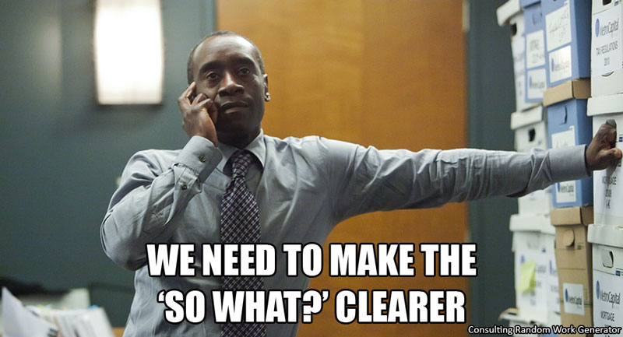
SCQA – The Quintessential Consultant

Slide 25
Method 2 – The Gold Standard

Slide 26
Business Case – The Gold Standard
Purpose & Problem Statement
Why are we doing this? Include customer segment and size of the prize
What does the market look like? How big is it?
What’s our current penetration?
Recommendation
What should we do to address the problem statement?
Conceptual Solution
Non technical diagram of solution
Benefits
Hard, Soft, Intangible

Slide 27
Business Case – The Gold Standard
Implementation Approach
Is there an MVP? What’s the timeline look like specific to functionality
Cost Benefit Summary
Include NPV, assumptions and discount rate
Key Risks
What could trip us up and how do we mitigate?
Summary
Is this solution practical? Next Steps?

Slide 28
Business Case – The Gold Standard – Common Example
Purpose & Problem Statement
Business stakeholders across the enterprise are unable to access customer data within 24 hours
Recommendation
Invest in a data architecture that includes an operational data store and enterprise data warehouse
Conceptual Solution
POS Data, e-commerce data and pharmacy prescription data replicates (Copied to) the Operational Data Store (ODS) and persists (Is kept) for 2 weeks before being deleted and stored in the EDW
See following slide

Slide 29
Business Case – The Gold Standard – Common Example
Raw Data
Instore - POS
Nightly Automated Copy Job
Enterprise Data Warehouse
Operational Data Store
Nightly Automated Copy Job
Instore - Pharmacy
Manual Daily Copy Job
Online - Ecommerce
2 Weeks of Data
Data Cubes and Aggregate Tables – 2 Years of Historical Data
Nightly Automated Copy Job

Slide 30
Business Case – The Gold Standard – Common Example
Benefits
Hard - $10MM in increased revenue due to increased offer response rate from personalized offers
Soft – Re-allocate people resources who normally pull and aggregate this data to higher level tasks
Implementation Approach
Run the current solution in parallel with ODS and EDW until data is validated
Cost Benefit Summary
Include NPV, assumptions and discount rate
Key Risks
Vendor that is providing technology
Change Management
Summary
Solution is similar to what our competitors are doing and is on our analytics roadmap

Slide 31
Method 3 – The Narrative

Slide 32
Monroe’s Motivated Sequence – Convince Someone By Telling a Compelling Story
Get The Audiences Attention
Use a shocking fact or an interesting stat
Gain Credibility
Evoke Curiosity
Define a Need – Define the Problem
Here’s proof that this is a serious problem
Here’s how this problem impacts your life, audience
Some people say this isn’t really a problem. I say they’re wrong, and here’s why
Satisfy the Need - Offer a Solution
Here’s how the solution works
Here’s proof that this solution does work to solve the problem
Some say this kind of a solution won’t work. I say they’re wrong, and here’s why

Slide 33
Monroe’s Motivated Sequence – Convince Someone By Telling a Compelling Story
Visualize the Consequences
Picture how much worse off we’ll be if we don’t move to use my solution
Picture how much better the world will be once we put my solution into place
Compare the Two
Call To Action
Because if you don’t
But if you do
Punch Line

Slide 34
Group Exercise – 45 Minutes
Review the Topic of Issue Given and Discuss A Recommendation
Prepare the SCQA for Your Recommendation
Present The Pitch To The Class
1 Minute

Slide 35
Topic 1
You work for a large movie studio that has a unique data asset. It’s a data set that contains the movie watching habits for 4 million people over the last 4 years, it includes their review of the movie as well. In your spare time, you’ve built a predictive model that is able to score whether or not a customer will enjoy a movie they’ve never seen before. You believe that this model can be useful to the studio.
You’re presenting to the movie executive team and asking for funding to pursue using this model. (Come up with a business use for this model (i.e. find people who have never watched star trek but would enjoy the movies if they watched them and try and convert these people to trekkies)

Slide 36
Topic 2
You work for an NBA team and your team has recently made it to the NBA finals. You have to price tickets for the finals but your team does not have a data driven methodology for pricing tickets. You’ve created an optimization model to calculate the price that maximizes revenue from these tickets, by individually pricing games, seats, concessions and other variables.
You’re presenting your findings on how to increase revenue to the board of directors. (Come up with relationships between tickets and variables (i.e. Lower bowl seats behind the bench are normally purchased for date night, therefore we should lower the price for those seats but increase the price of drinks and shareable snacks)

Slide 37
Topic 3
You’re a corporate manager for a large bank. You’ve identified an opportunity to target a specific customer group but do not have enough analytics resources to identify these customers.
You’re presenting your case to your manager hire additional analytics talent. (Come up with the customer group (i.e. Middle aged men who frequent burrito shops) and opportunity (Provide a cashback credit card for Mexican food)

Slide 38
Topic 4
You work for a large retailer. You have a loyalty program that collects data on customers today, and have surfaced really interesting insights on product relationships. However you do not have an email service provider and thus cannot send targeted communications to your customers.
You’re presenting to the board for funding of an email service provider. (Come up with a segment (i.e. middle-aged fathers) and a product correlation (i.e. diapers and beer)

Slide 39
Topic 5
You work for a university. You’ve built a model that can predict which students will struggle in a specific masters program. You’d like to use the model to score students and then provide pre-emptive help and support.
You’re presenting your case to the provost. (Come up with a student segment (i.e. male, vegan math students who live at home) and indicator variable relationship (i.e. the more Rockstar energy drink they drink, the less likely they are to fail)

Slide 40
Topic 6
You work for a fitness studio with a cult following. Your business has been doing so well that you’ve been tasked with finding the location of the next studio. You’ve built an optimization model to determine the right location based on a many different variables.
You’re presenting your recommendation for the new location to the fitness studio founder. (Come up with the location (Caledon) reason (Our workout simulates horseback riding and many people in the area already horseback ride)

Slide 41
Summary

Slide 42
